Slide 1
Clinical Scoring system for CoVid-19
Nazarbayev Intellectual Schools of Physics and Mathematics in Taraz
Research coordinators:
Mirlan Jussambayev
Maksim Rybalkin
Aneliya Abdimalik,
Abylai Sydykov
12th grade students

Slide 2
Objective of the study:
to minimize the risks of COVID-19 infection among medical personnel by developing a remote monitoring system for indicators of clinical symptoms of coronavirus infection.
Relevance:
high risk of infection among medical staff
high economic costs for personal protective equipment
Hypothesis:
the developed device allows remote monitoring of the clinical symptoms of patients with COVID-19, which, in turn, will reduce the level of infection of the virus by medical personnel when examining a patient.

Slide 3
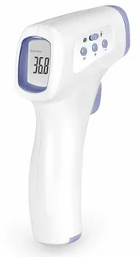
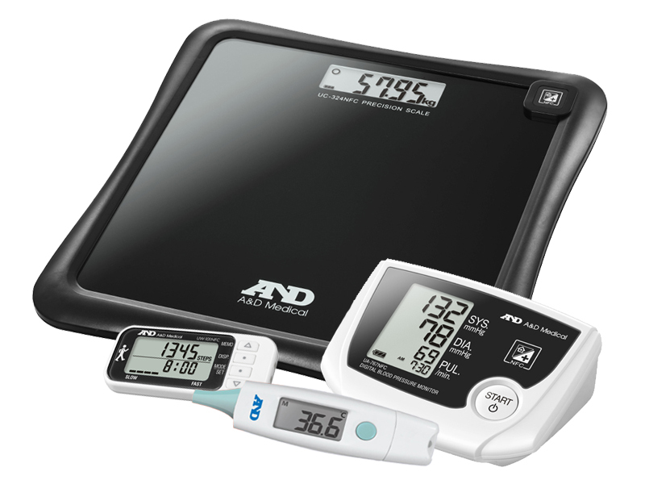
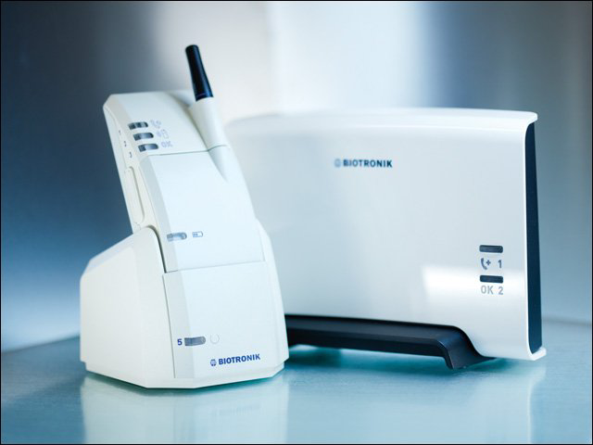
Objective 1. Conduct analytical review of analogs in market
Significant disadvantages:
The need for direct physical contact
The high cost of devices
Lack of data systematization to track dynamics
Figure 1. A&D Medical Wellness Connected
Figure 2. Non-contact thermometer B.Well WF-4000
Figure 3. Biotronik Home Monitoring

Slide 4
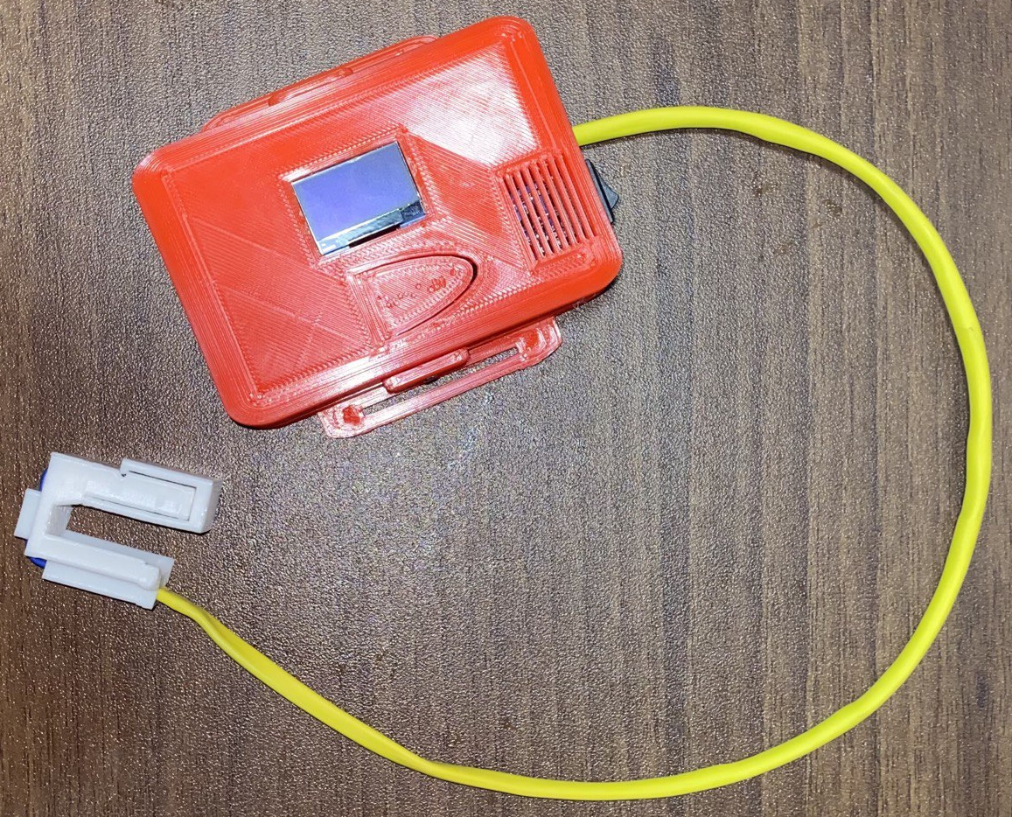
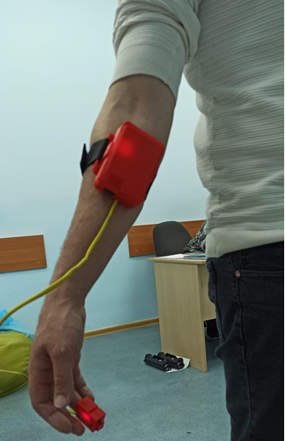
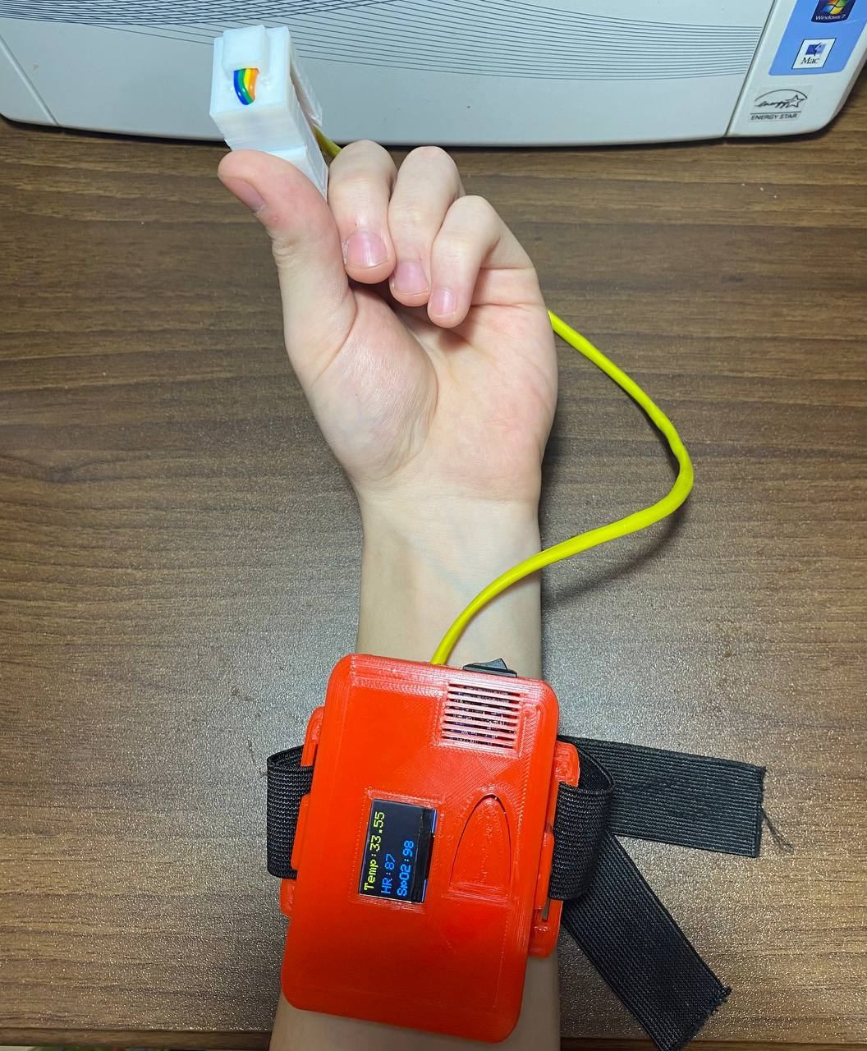




Objective 2.1. Develop Clinical Scoring system for CoVid-19
Figure 4. Physical device
Figure 5. Device on hand
Figure 6. Scoring process
Figure 7. Arduino
Figure 8. PHP
Figure 9. HTML, CSS, JS
Figure 10. MySQL

Slide 5
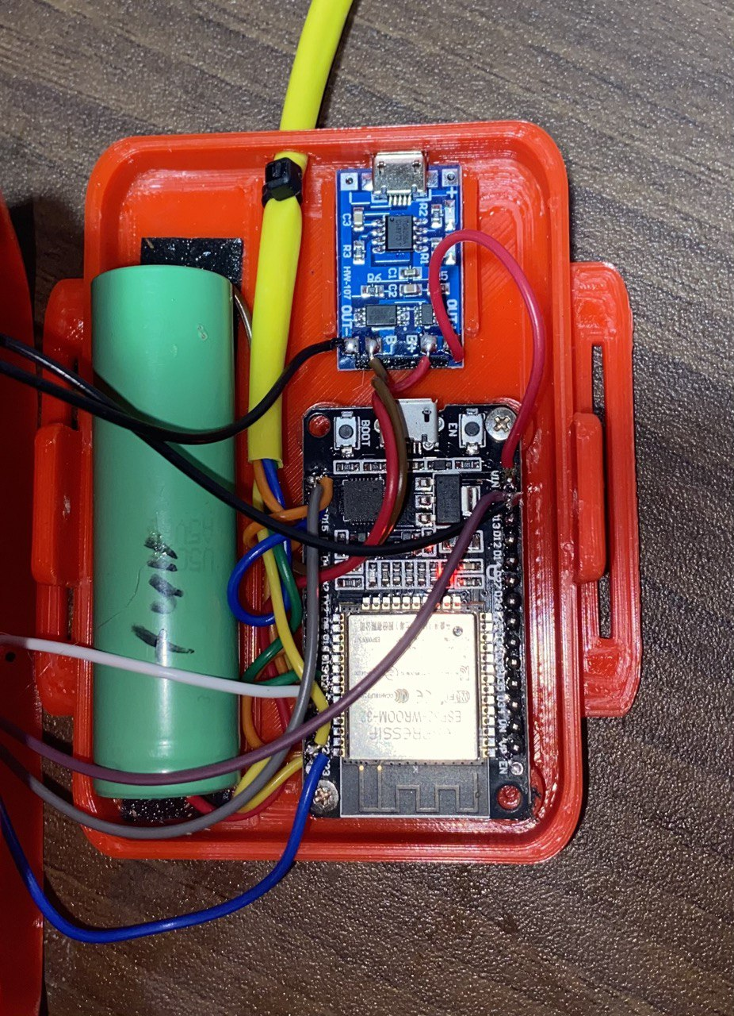
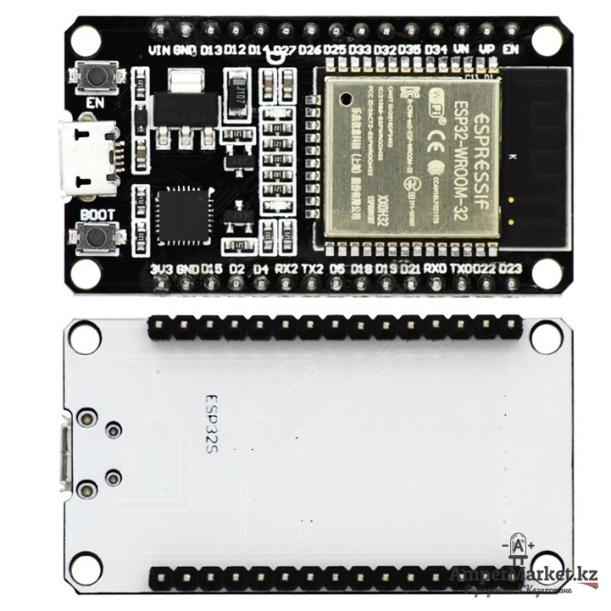
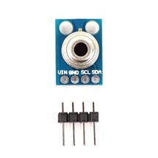
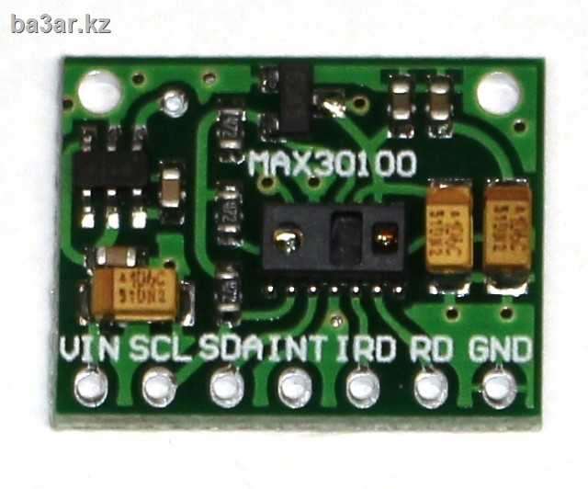
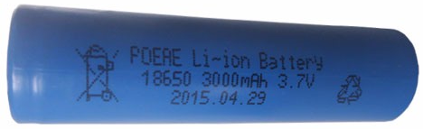
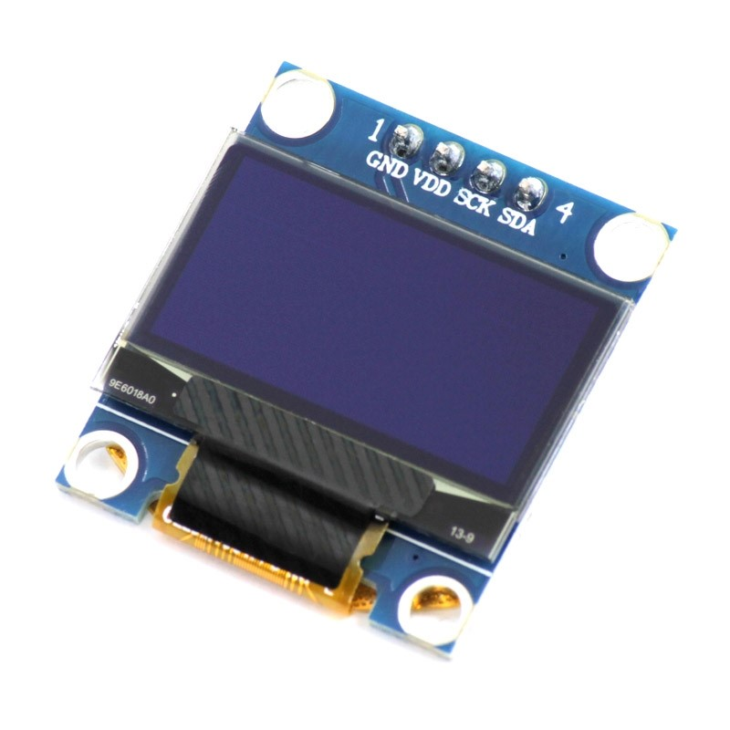
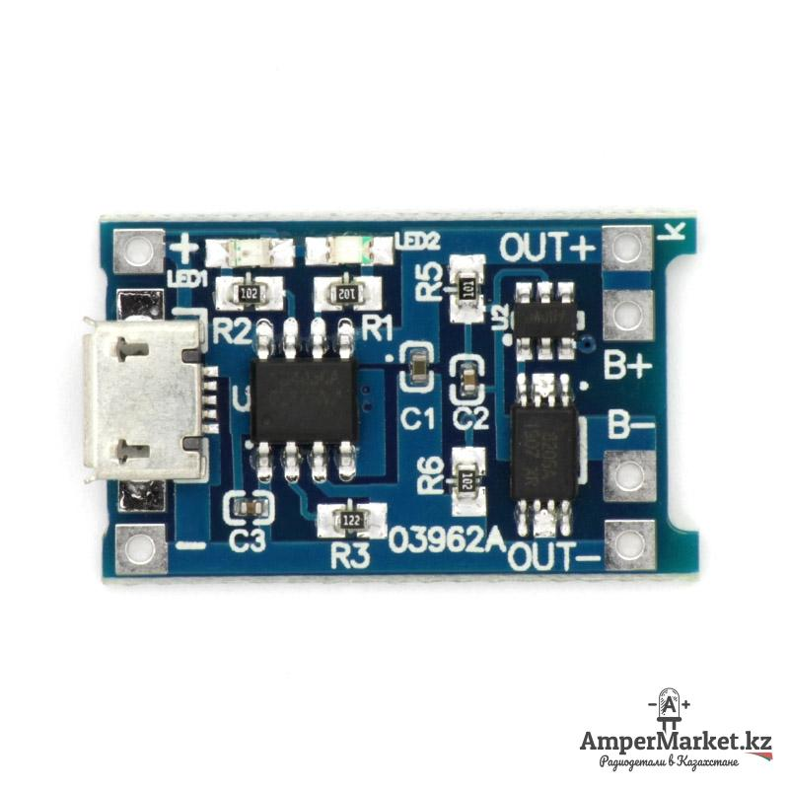
Objective 2.2. construct the electrical circuit to build a device
Figure 11. IR temperature sensor GY-906
Figure 12. Pulse oximeter MAX30100
Figure 16. Board ESP-WROOM-32 (Wi-Fi, Bluetooth)
Figure 13. Charging module TP4056 1A with overload protection
Figure 15. OLED-display 128х64
Figure 14. Battery Li-ion 3.7V, 3000 mAh

Slide 6
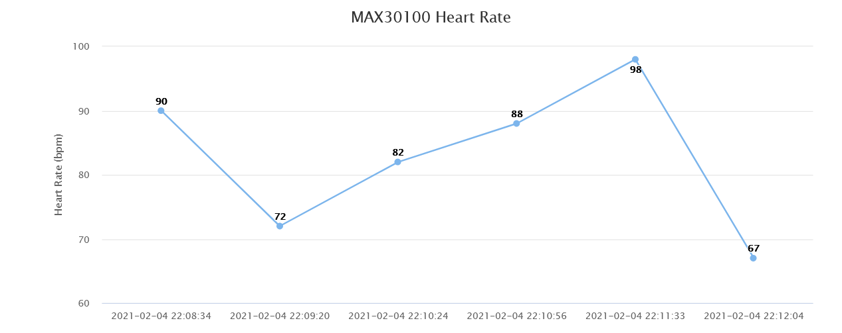
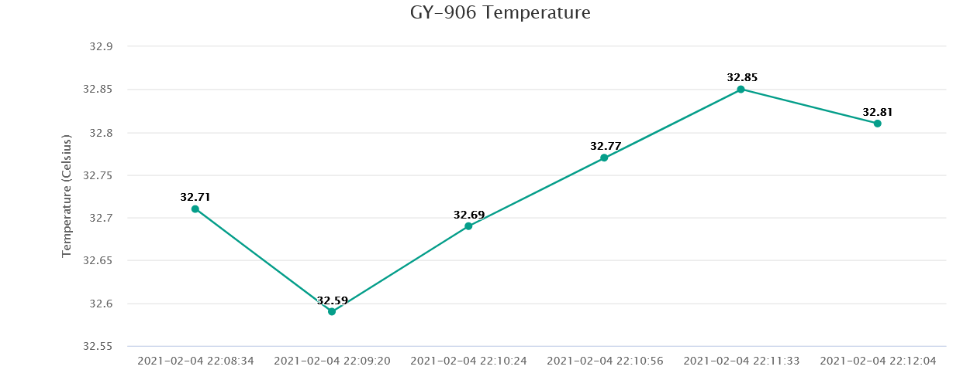
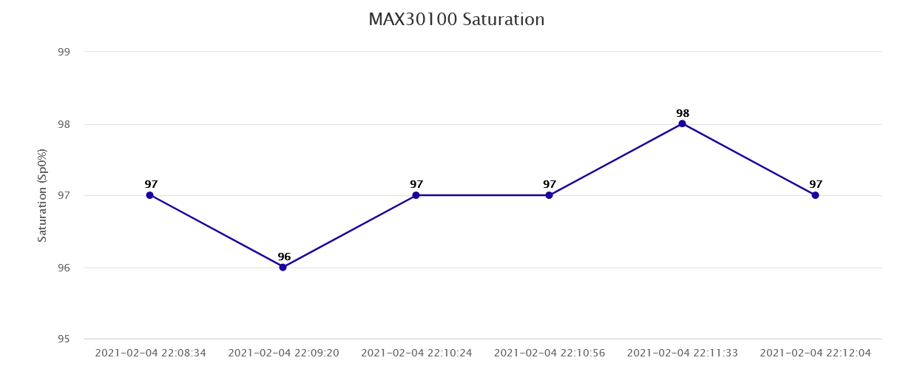
Objective 2.3. Control the synchronism of data transmission

Slide 7
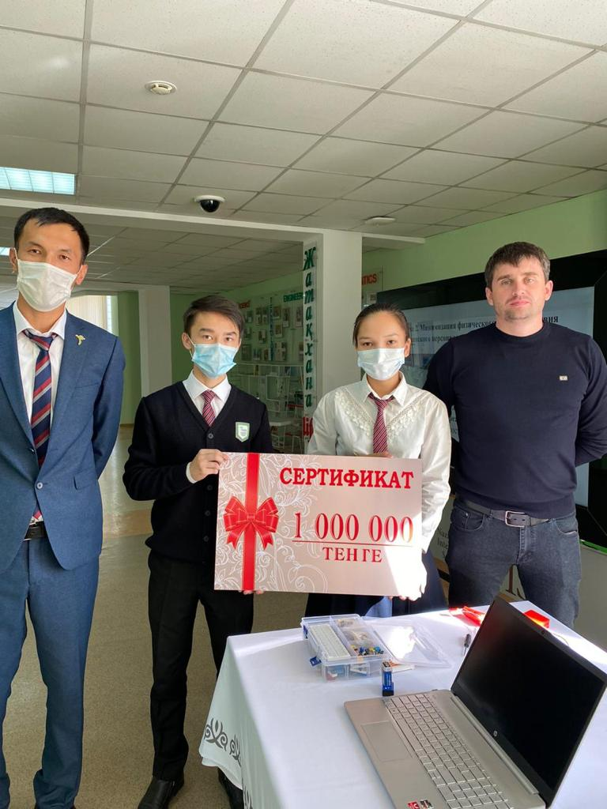
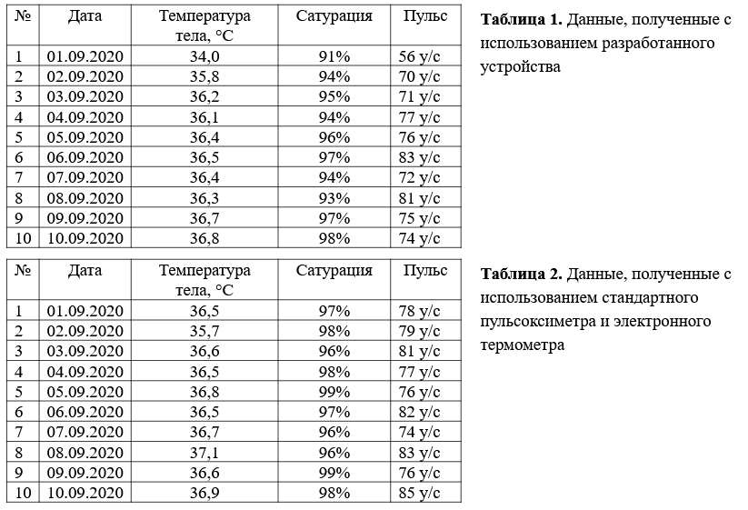
Approbation of project results
Testing for 10 days on healthy people
Received funding from the regional akimat
Undergoing examination for a utility model patent

Slide 8
Conclusion
The developed device and web application will allow:
Reduce the risk of COVID-19 infection by medical personnel
No need to wear protective equipment when monitoring patients
Large coverage of patients with a small number of medical staff
Alert system allows you to quickly respond to deterioration in the patient's condition
Possibility of use in hospital treatment
Safety in use, personal data of patients will be protected and available only to medical organizations
The cost of one device is 20,000 tenge

